Slide 1
Subawards
How to review a subrecipient invoice

Slide 2
Subrecipient monitoring Policies
Under the OMB Uniform Administrative Requirements, Cost Principles, and Audit Requirements (2 CFR 200 Uniform Guidance), pass-through entities are required to monitor the programmatic and financial activities of their subrecipients to ensure proper stewardship of sponsored funds.

Slide 3
Subrecipient monitoring
This procedure addresses institutional responsibilities and assists Principal Investigators and staff in ensuring that, in addition to achieving performance goals, subrecipients comply with Federal laws and regulations, University policies, and with the provisions of any agreements that govern the subaward.
Review procedures apply to all subawards issued under both Federal and Non-Federal sponsored programs made to the University. This procedure does not apply to professional services and consultant agreements or the procurement of goods or services from contractors.

Slide 4
Principal investigator review
Principal Investigators (PIs) – PIs have the primary responsibility for:
Monitoring subrecipients’ progress
Ensuring compliance with Federal regulations and the award terms and conditions of both the prime recipient and subrecipient
Communicating with the Office of Research Administration/Services (ORA/ORS) if changes need to be made to the statement of work, reporting requirements, budgeting, etc.
Reviewing and approving subrecipient invoices
Ensuring timely receipt of programmatic reports

Slide 5
PI Responsibilities
PIs must communicate regularly with subrecipient PIs and review progress/programmatic reports or other specified deliverables on a timely basis to ensure the subaward funds are being used for authorized purposes and that performance goals are being achieved. Any issues should be communicated to the Grants & Contracts Accounting (GCA) / Research Financial Services (RFS) Subrecipient Analyst and a course of action discussed.
PIs must review the expense to budget comparison for cost reimbursement subawards. The subrecipient’s invoices are generally required to show both current period and cumulative expenses.

Slide 6
PI responsibilities
PIs and GCA/RFS staff are responsible for reviewing and documenting the review of financial reports and invoices received from the subrecipient to ensure that they follow Federal statutes, regulations, and the terms and conditions of the subaward. The Subrecipient Invoice Checklist must be used as a guide for reviewing subrecipient invoices.
PIs and GCA/RFS staff are responsible for verifying that the subrecipient is adequately meeting any cost sharing commitments made under the terms of the subaward and that the subrecipient's indirect costs charged follow the indirect cost rate specified in the subaward.

Slide 7
PI Responsibilities
PIs and/or GCA/RFS staff should request that the subrecipient provide clarification of invoiced charges that appear unusual, excessive, or otherwise questionable. GCA/RFS staff may request detailed justification to verify the costs are allowable.
PIs should communicate with GCA/RFS and ORA/ORS regarding any change in expectations of performance of work, payment terms, change in key personnel, reporting requirements, budgeting, deliverables, etc. If work stops or a change in the scope of work results, ORA/ORS and GCA/RFS should be notified, and appropriate agreement changes implemented.

Slide 8
Things to think about when reviewing
Questions
When is the last time the PI spoke with subrecipient regarding project?
Is the PI satisfied with subrecipient performance?
How fast is the subrecipient using their budget?
Is the subrecipient spending according to budget?
Are there any unresolved issues?
Has the scope of work changed?

Slide 9
Possible Red flags
The subrecipient invoices for all expenses within first few months of the project.
Subrecipient institution invoices for categories that weren’t included in the budget and don’t seem relevant to the project.
Subrecipient institution continues to send invoices, but no progress reports have been received and PI at sub institution has not been attending status meetings.
Work received from subrecipient institution seems questionable or subpar.
Invoice contains multiple errors (time period, math, titles)

Slide 10
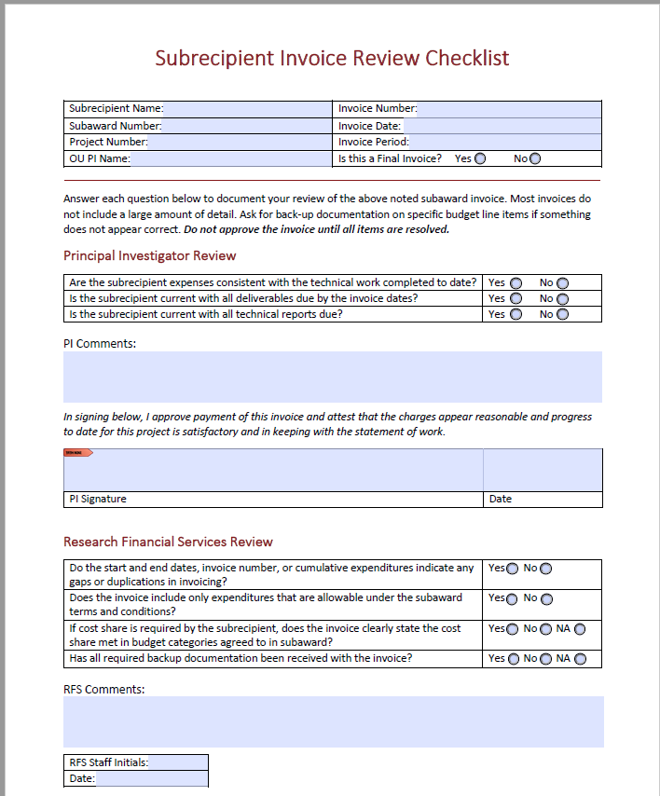
Form

Slide 11
Subrecipient invoice review checklist signature
The approval of the PI signifies the invoice was reviewed for reasonableness, that all costs appear appropriate, are consistent with relevant terms and conditions of the award, and the subrecipient is making adequate progress toward the aims of the subaward.
Signature does not mean that you are guaranteeing compliance, but to your knowledge, it appears progress is being made and that funds are being spent in accordance with the terms of the agreement.

Slide 12
Payment
If the PI agrees with the invoice and has signed the subrecipient invoice checklist, the form along with the invoice should be forwarded for payment. Review and signature must be completed within 10 days of receipt unless there are items that need follow up.
If the PI’s department uses Shared Business Services, then forward to sbsc@ou.edu.
If the PI’s department has their own administrative staff, the form and invoice should be forwarded to them for processing.
University has 30 days to pay subrecipients from the date of receipt of the invoice unless there are documented concerns with the invoice that University staff are working with the sub to resolve.

Slide 13
Questions
Research Financial Services - Norman
Kindra Lenzmeier – Subrecipient Analyst (refsinvoices@ou.edu)
Joel Miller – Lead Post Award Grant Manager
Don Smith – Director
Office of Research Service – Norman (subawards@ou.edu)

